Slide 1
Periocular Face Recognition Enhanced with Soft Biometrics Under Unconstrained Environments
New Research Proposal
Nasser M. Nasrabadi and Veeru Talreja (WVU)
Project #21S-07W
Spring 2021

Slide 2
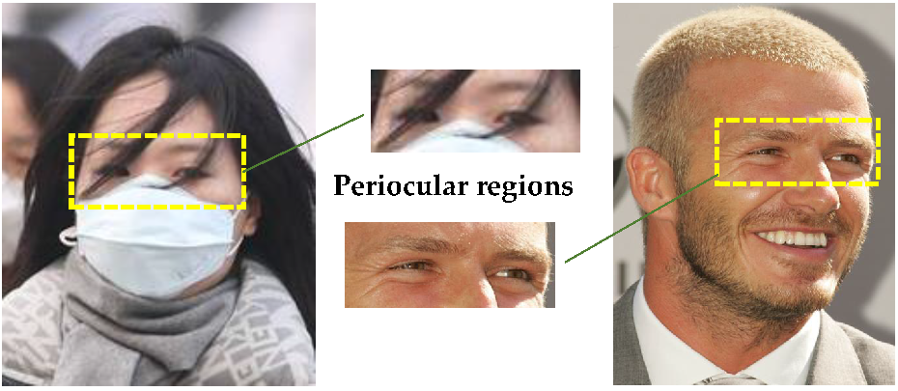
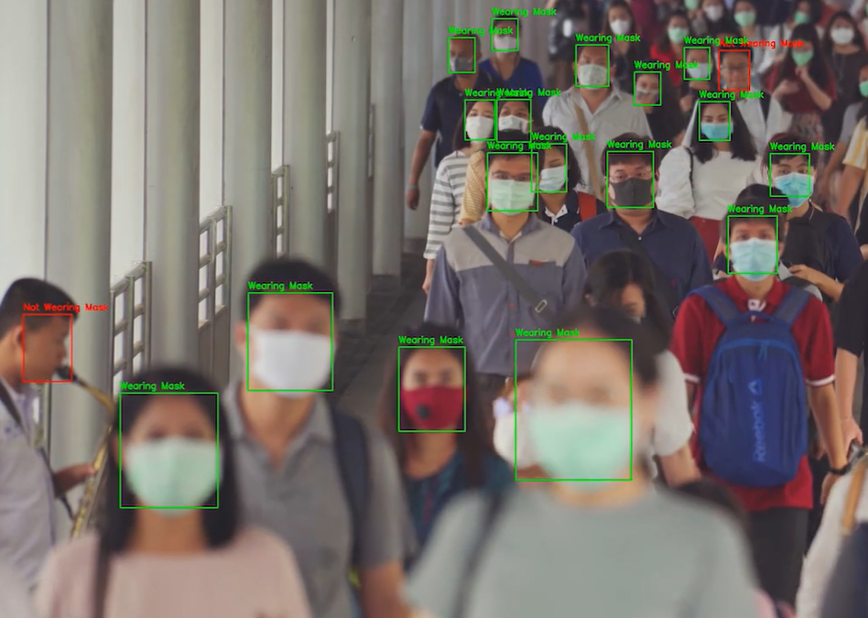
Problem Periocular Recognition with Soft Biometrics:
Motivation for research
We address the challenges of periocular face recognition in an unconstrained wild environment (i.e., masked faces due to COVID-19 pandemic). We also address the challenge of predicting and integrating soft biometrics into our proposed periocular face recognition algorithm.
How to incorporate soft biometrics information (e.g., age, gender, ethnicity) into a periocular face recognition algorithm to improve the overall recognition accuracy.
Value?
Why is this important to affiliates, biometric community, etc.
Due to COVID-19, pandemic masked faces are becoming a norm. Therefore, developing a periocular face recognition algorithm with its performance enhanced with soft biometric traits is important to affiliates, etc.
Notes:
Given the use of masks due to the COVID-19 pandemic, the face appears occluded even in cooperative settings, leaving the ocular region as the only visible part.

Slide 3
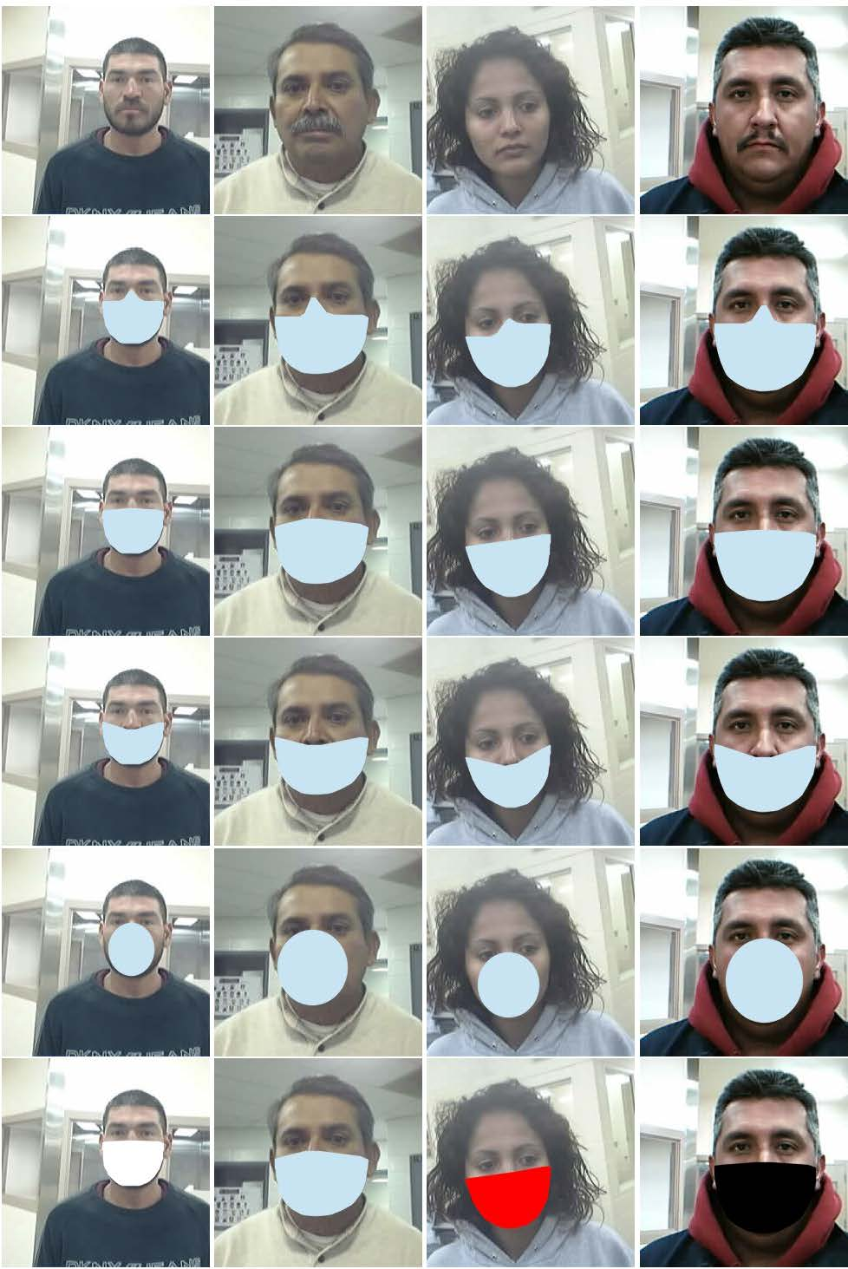
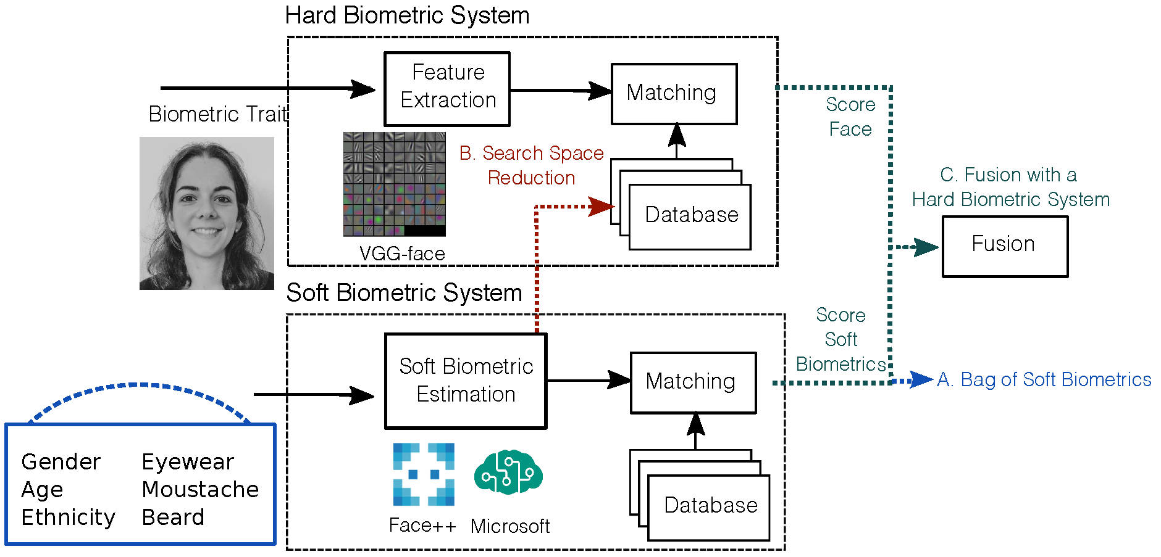
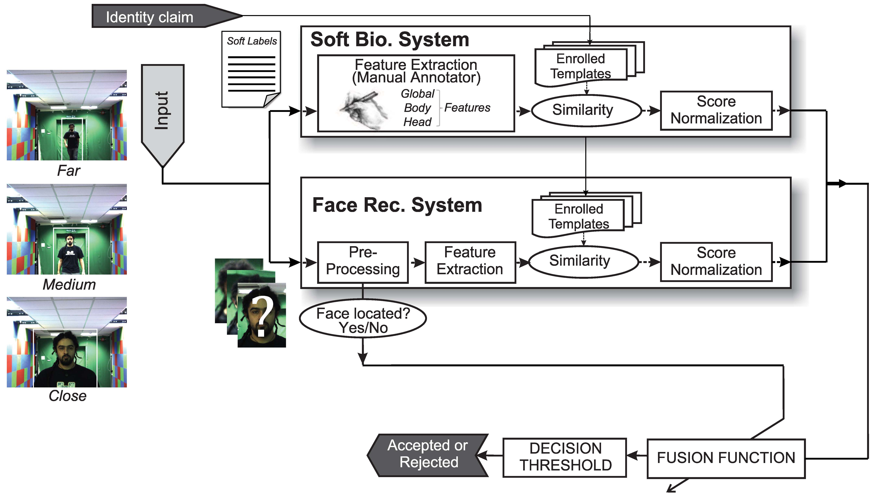
Work Elsewhere
Deep Learning-Based Multi-View Face Recognition Algorithms:
NIST report on “Face recognition accuracy with face masks using post-COVID-19 algorithms,” https://doi.org/10.6028/NIST.IR.8331, Nov. 2020.
NIST researchers quantified the accuracy of 65 face recognition algorithms on faces occluded by masks applied digitally to a large set of photos. They reported that FR developers that submitted algorithms after the pandemic showed significantly improved accuracy.
E. Gonzalez-Sosa, J. Fierrez, R. Vera-Rodriguez and F. Alonso-Fernandez, "Facial soft biometrics for recognition in the wild: Recent works, annotation, and COTS evaluation," in IEEE Transactions on Information Forensics and Security, vol. 13, no. 8, pp. 2001-2014, Aug. 2018
They fused soft biometrics with two state-of-the-art face recognition systems based on deep learning. They observed that soft biometrics is a valuable complement to the face modality in unconstrained scenarios.
P. Tome, J. Fierrez, R. Vera-Rodriguez, and M. S. Nixon, “Soft biometrics and their application in person recognition at a distance,” IEEE Transactions on Information Forensics and Security, Vol. 9, No. 3, pp. 464-475, March 2014.
This paper used soft biometric labels as ancillary information to improve challenging person recognition scenarios at a distance.

Slide 4
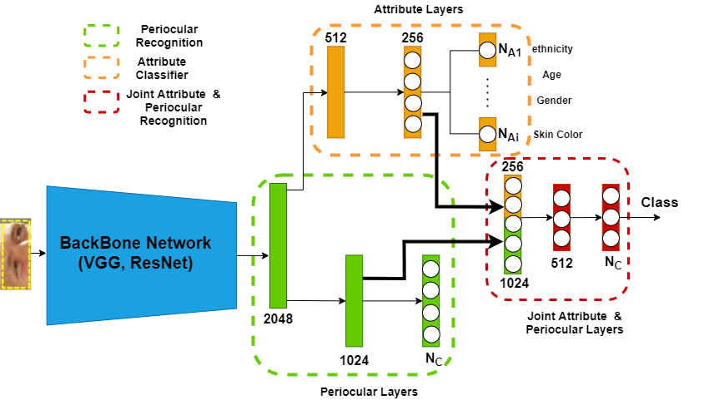
Our Approach
A Joint Periocular & Soft Biometrics Face Recognition
We propose a deep periocular face recognition enhanced with the predicted soft biometrics (age, gender, race, skin color).
The network consists of a shared backbone and dedicated attribute layers and periocular layers. The whole network is
trained end-to-end, and the attribute feature layer is jointly fused with the periocular feature layer to make the final face classification.
What is Innovative and New?
A novel joint facial attribute and periocular face recognition is proposed. The facial attribute is an ancillary information that can improve the periocular overall face recognition accuracy.

Slide 5
Research Plan
Preprocess publicly available periocular databases with soft biometrics (e.g., FRGC, Cross-Eyed, UBIPr).
Investigate the effect of different periocular and soft biometrics attribute feature vector sizes.
Study the effect of different numbers of predicted soft biometrics on performance.
Compare the performance of our model with/without the soft biometrics.
Evaluate performance of our proposed periocular recognition using the ROC & DET plots and EER & AUC scores.
State risks for the project: There is no risk involved in this project. This project is built upon our previous research published in CVPR Biometrics 2018 “A deep face identification network enhanced by facial attributes prediction,” (won the best student paper award in CVPRW18).
Notes:
In order to disentangle the turbulence distortion into blur and deformation, the deblur function Gd and the deformation correction function Gb are built.
In this paper, we propose a GAN model constrained by a physics model for image restoration and low-level vision tasks. The physics model ensures that the estimated result (i.e., G(y)) should be consistent with the observed image y. The proposed physics constrained GAN model is jointly trained in an end-to-end fashion.
Let xi}iN=1 and {yi}iN=1 denote the clear and corresponding blurred images. The generative network learns the mapping function G and generates the intermediate deblurred image G(yi) from the input yi. Then, we apply the image degradation model (1) to G(yi)
􀀀i = ki ⊗ G(yi),
where ki denotes a blur kernel used only in the training process2, and ⊗ denotes the convolution operator. The discriminative network Dh takes the blurred image yi and the regenerated image y􀀀i as the inputs to classify whether the generated results satisfy the blur model or not. The other discrimina-tive network Dg takes the ground truth xi and the intermediate deblurred image G(yi) as the inputs to classify whether G(xi) is clear or not.

Slide 6
Outcomes, Importance, Deliverables
Outcomes – A novel periocular face recognition algorithm enhanced with the predicted soft biometrics attributes.
Importance – A high-performing periocular face recognition is important for identifying persons with masked faces due to the COVID-19 pandemic.
Deliverables | Delivery Date
Software: All the algorithms with computer codes can be provided to affiliates for testing. | Spring 2022
Datasets: All evaluation datasets can be provided to affiliates. | Spring 2022
Other: A comprehensive evaluation report can be provided to affiliates with regard to our periocular face recognition enhanced with soft biometrics. | Spring 2022
Notes:
Given the use of masks due to the COVID-19 pandemic, the face appears occluded even in cooperative settings, leaving the ocular region as the only visible part.

Slide 7
Backup Slides
Next Three Slides are Milestones, Related Funding & IP and Quad-Chart

Slide 8

Questions?

Slide 9
Milestones
Milestone | Description and Deliverable | Timeframe
(1) Preprocess the selected periocular face databases with soft biometrics | Preprocess publicly available periocular databases with soft biometrics (e.g., FRGC, Cross-Eyed, UBIPr). Review and evaluate the current state-of-the-art on multi-view face recognition in the literature. | 2 months
(2) Implement the deep periocular face recognition | Implement our proposed joint periocular and soft biometrics face recognition. Investigate the effect of the number of soft biometrics attributes on performance. | 4 months
(3) Evaluate the performance of the Periocular FR algorithm | Evaluate the performance of the proposed deep periocular face recognition with/without the soft biometrics' attributes. | 4 months
(4) Validate results and report performance evaluation | Report overall performance using ROC & DET plots and EER & AUC scores. Write the final report and presentation. | 2 months

Slide 10
Related Funding and IP
Prior Funding
NONE
Current Related Funding (indicate how projects are different)
NONE
Intellectual Property
-An prior IP to declare, e.g., provisional patent applications, patent application, patents, licensing arrangement: NO
-Conflicts of interest (ownership, licensing, consulting payments, etc.) in area of proposal: NO
-Possible future IP: YES

Slide 11
Periocular Face Recognition Enhanced with Soft Biometrics Under Unconstrained Environments, #21S-07W
N. Nasrabadi & V. Talreja (WVU)
Objective and Approach
Objective:
Design a deep periocular face recognition algorithm that is enhanced by the predicted soft biometrics attributes.
Approach:
The predicted soft biometrics information is integrated into the periocular face recognition algorithm.
Milestones (from proposal)
Outcomes
A novel periocular face recognition algorithm:
A deep periocular face recognition algorithm that is integrated with the soft biometrics attributes that is predicted from the periocular region.
Deliverables
Software, databases and technical report.
Milestone | Description and Deliverable | Timeframe
(1) Preprocess the selected periocular faces with soft biometrics | Preprocess publicly available periocular databases with soft biometrics (e.g., FRGC, Cross-Eyed, UBIPr). Review and evaluate the current state-of-the-art on multi-view face recognition in the literature. | 2 months
(2) Implement the deep periocular face recognition | Implement our proposed joint periocular and soft biometrics face recognition. Investigate the effect of the number of soft biometrics attributes on performance. | 4 months
(3) Evaluate the performance of the Periocular FR algorithm | Evaluate the performance of the proposed deep periocular face recognition with/without the soft biometrics' attributes. | 4 months
(4) Validate results and report performance | Report overall performance using ROC & DET plots and EER & AUC scores. Write the final report and presentation. | 2 months

